Slide 1


Polio: Global & National Update
Overview: Pulse Polio NID (3rd February 2019)
Dr. Anilkumar S. Talikoti
SMO
WHO - India, Kalaburagi

Slide 2
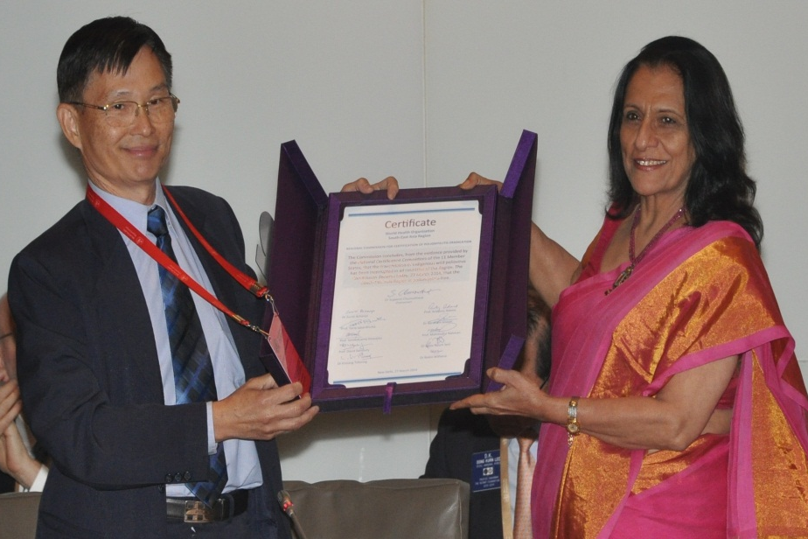

Polio-free certification A historic milestone for India..
South-East Asia Region of WHO, including India, certified POLIO-FREE on 27th March 2014
Monumental success for India and the global polio eradication programme
Considering that in 2009 India accounted for more than 50% of global polio cases
Country remains polio free for more than 7 years

Slide 3
Global Update

Slide 4
WPVs in Endemic Countries, 2016-18*
Year | Total Cases
2016 | 34
2017 | 22
2018* | 29
cases
Data in WHO HQ as of 11 Dec 2018

Slide 5
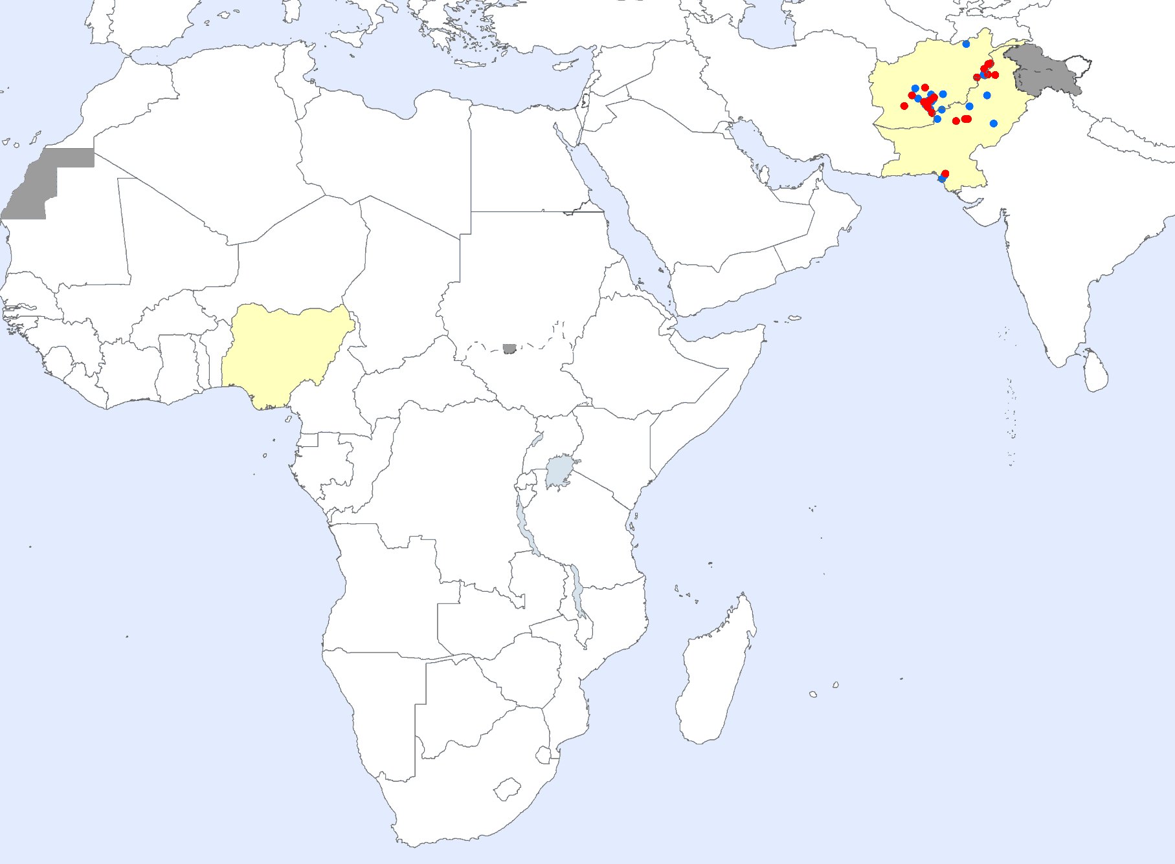
Wild Poliovirus Cases: 2017 (22) and 2018 (27*)
Afghanistan:
19 WPV1 in 2018 (14 WPV1s in 2017)
Most Recent onset : 2 Oct 2018
Last WPV 3 detected 6 years ago
July 2012 (FATA, Pakistan)
November 2012 (Yobe, Nigeria)
Pakistan:
8 WPV1 in 2018 (8 WPV1s in 2017)
Most Recent Onset: 7 Oct 2018
Nigeria:
Last case: 21 Aug 2016
Last WPV detected : 27 Sep 2016
Wild poliovirus type 1 2018
Wild poliovirus type 1 2017
Endemic country

Slide 6
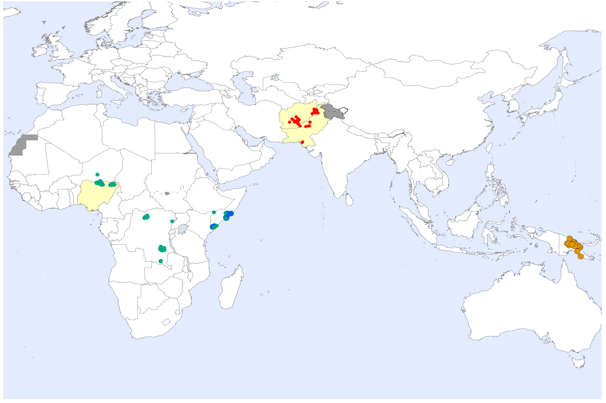
Global Wild Poliovirus & cVDPV Cases¹ Past 12 Months²
Wild poliovirus type 1
cVDPV type 1 cVDPV type 2
cVDPV type 3
Endemic country
¹Excludes viruses detected from environmental surveillance ²Onset of paralysis 07 Nov. 2017 – 06 Nov. 2018

Slide 7
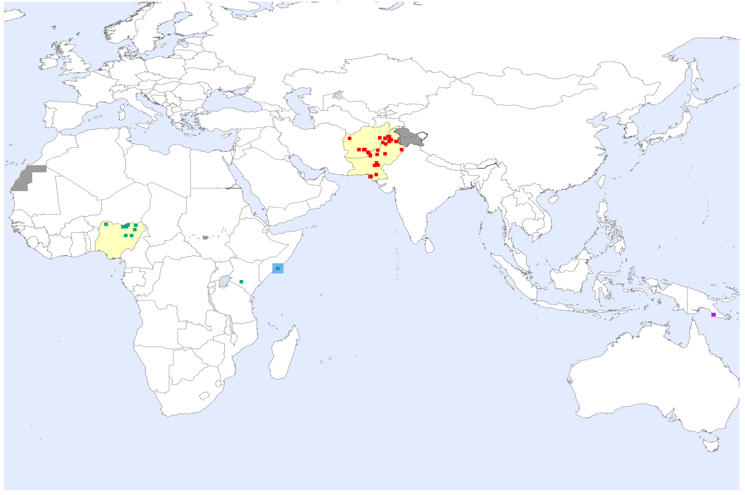
Wild Poliovirus & cVDPV Environmental Positives¹ Past 12 Months²
Wild poliovirus type 1
cVDPV type 1
cVDPV type 2
cVDPV type 3
Endemic country
¹Excludes viruses detected from AFP surveillance.
²Collection date: 07 Nov. 2017 – 06 Nov. 2018

Slide 8
Wild Poliovirus & cVDPV Environmental Positives¹ Past 12 Months²
Public Health Emergency of International Concern
First declared under the International Health Regulations in May 2014
Confirmed on 15 August 2018
Wild poliovirus type 1
cVDPV type 1
cVDPV type 2
cVDPV type 3
Endemic country
¹Excludes viruses detected from AFP surveillance.
²Collection date: 07 Nov. 2017 – 06 Nov. 2018

Slide 9
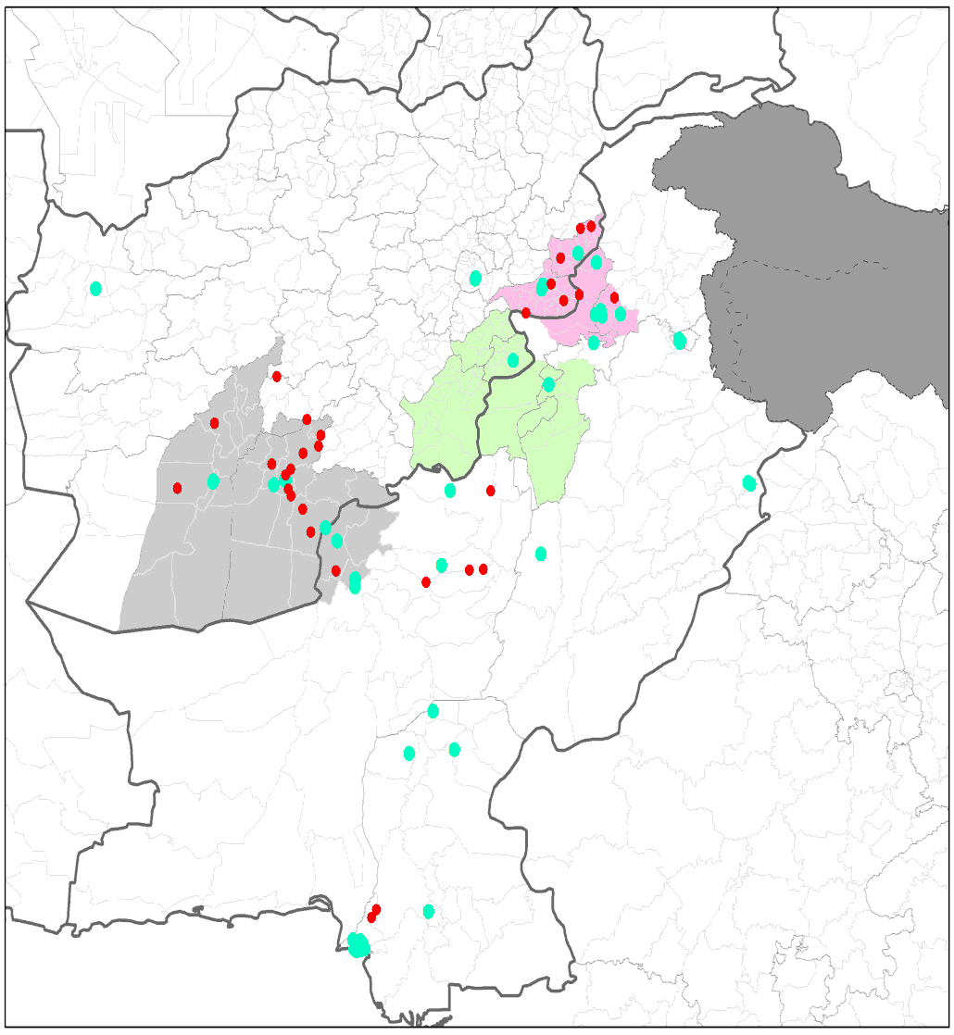
Afghanistan
Ongoing transmission of wild poliovirus in Northern and Southern corridors
Genetic sequencing data shows that population groups harboring transmission in the Northern Corridor have not been reached.
Ban on house to house campaigns: Over 1 million children missed since May
Gaining & maintaining access remains the most significant bottleneck to stopping transmission
Northern
Central
Southern
Cases
Positive ES sites
Data in WHO HQ as of 23 Oct. 2018

Slide 10
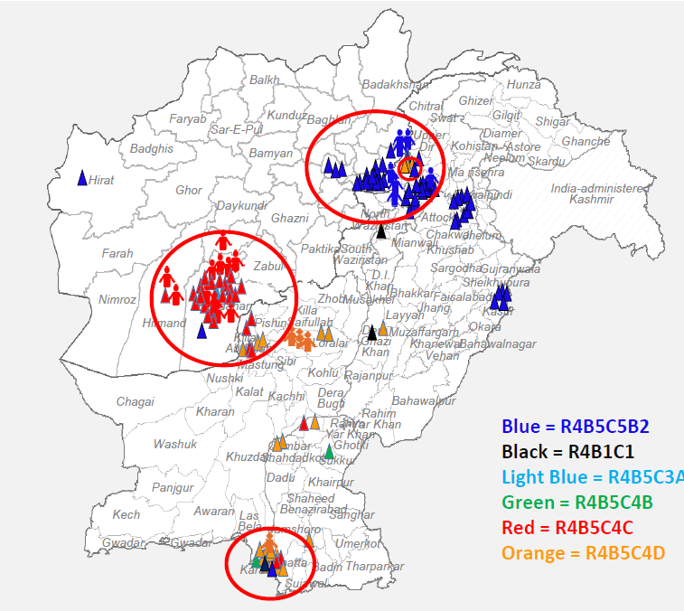
Pakistan
8 WPV1 cases in 2018 vs 5 at same date in 2017.
Most recent case had paralysis onset on 7 October, 2018
Environmental positive samples isolated primarily in core reservoirs but also outside areas
Northern and Southern Transmission Corridors, and Karachi, remain the greatest risk to polio eradication in Pakistan & Afghanistan
WPV1 Cases & ES+, by Cluster, 2018

Slide 11
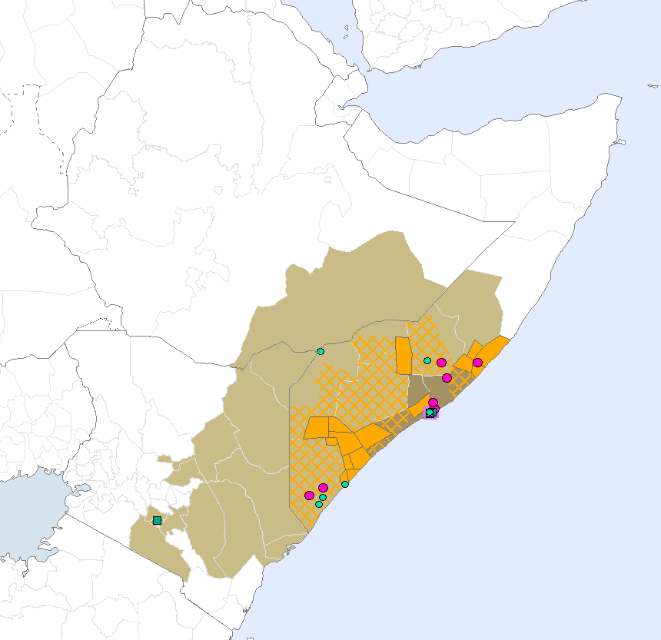
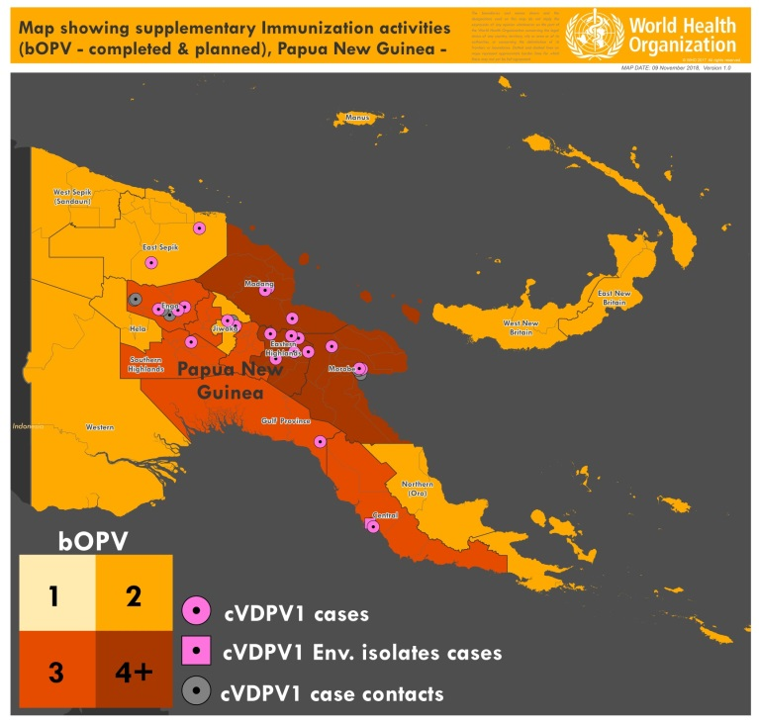
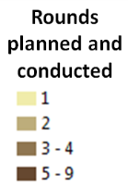
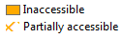
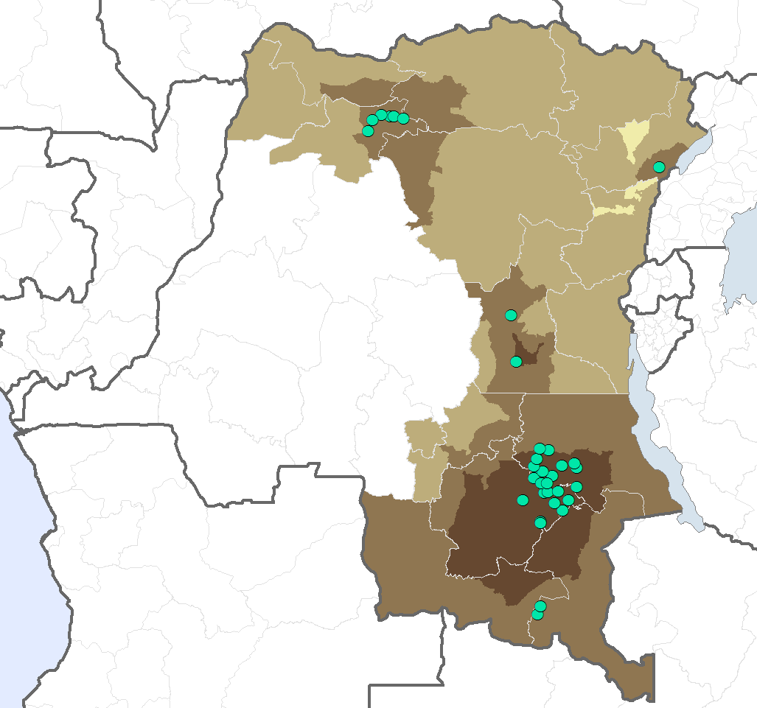
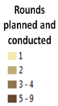
Ongoing cVDPV outbreaks
DRC: 37 cVDPV2 cases since May 2017
HoA: 5 cVDPV2 cases,
6 cVDPV3 cases and
1 co-infection since October 2017
PNG: 21 cVDPV1 since 25 April 2018
11
Notes:
Talking points:
First case detected 20/02/17 and last case detected. 22/07/18
35 cVDPV2 cases during 2017 (22) & 2018 (11)
6 infected provinces & 12 infected districts
3 distinct cVDPV2 outbreaks:
Haut Lomami/Tanganyika outbreak, expanded to Ituri - 27 cases
Mongala outbreak - 6 cases
Maniema outbreak – 2 cases
Polio & Ebola response teams coordinating closely at all levels

Slide 12

Polio Eradication and Endgame Strategy
Poliovirus detection & interruption
OPV2 withdrawal, IPV introduction, immunization system strengthening
Containment & Global Certification
Transition Planning

Slide 13
Coverage of OPV-1, IPV-1 and Penta-1

Slide 14
Coverage of OPV-3, IPV-2 and Penta-3

Slide 15
Countries using IPV vaccine to date
Introduced* to date (176 countries)
Re-introduced (15 countries)
Formal commitment to introduce in 2018-2019 (3 countries)
Not available
Not applicable
Data source: WHO/IVB Database, as of 11 October 2018
Map production Immunization Vaccines and Biologicals (IVB), World Health Organization
* Including partial introduction in India
15
Notes:
Introductions still planned for 2018
Malawi Mongolia
Introduction planned for 2019/Q1: Zimbabwe

Slide 16
Missed cohorts in affected countries

Slide 17
Polio Eradication and Endgame Strategy
Poliovirus detection & interruption
OPV2 withdrawal, IPV introduction, immunization system strengthening
Containment & Global Certification
Transition Planning

Slide 18
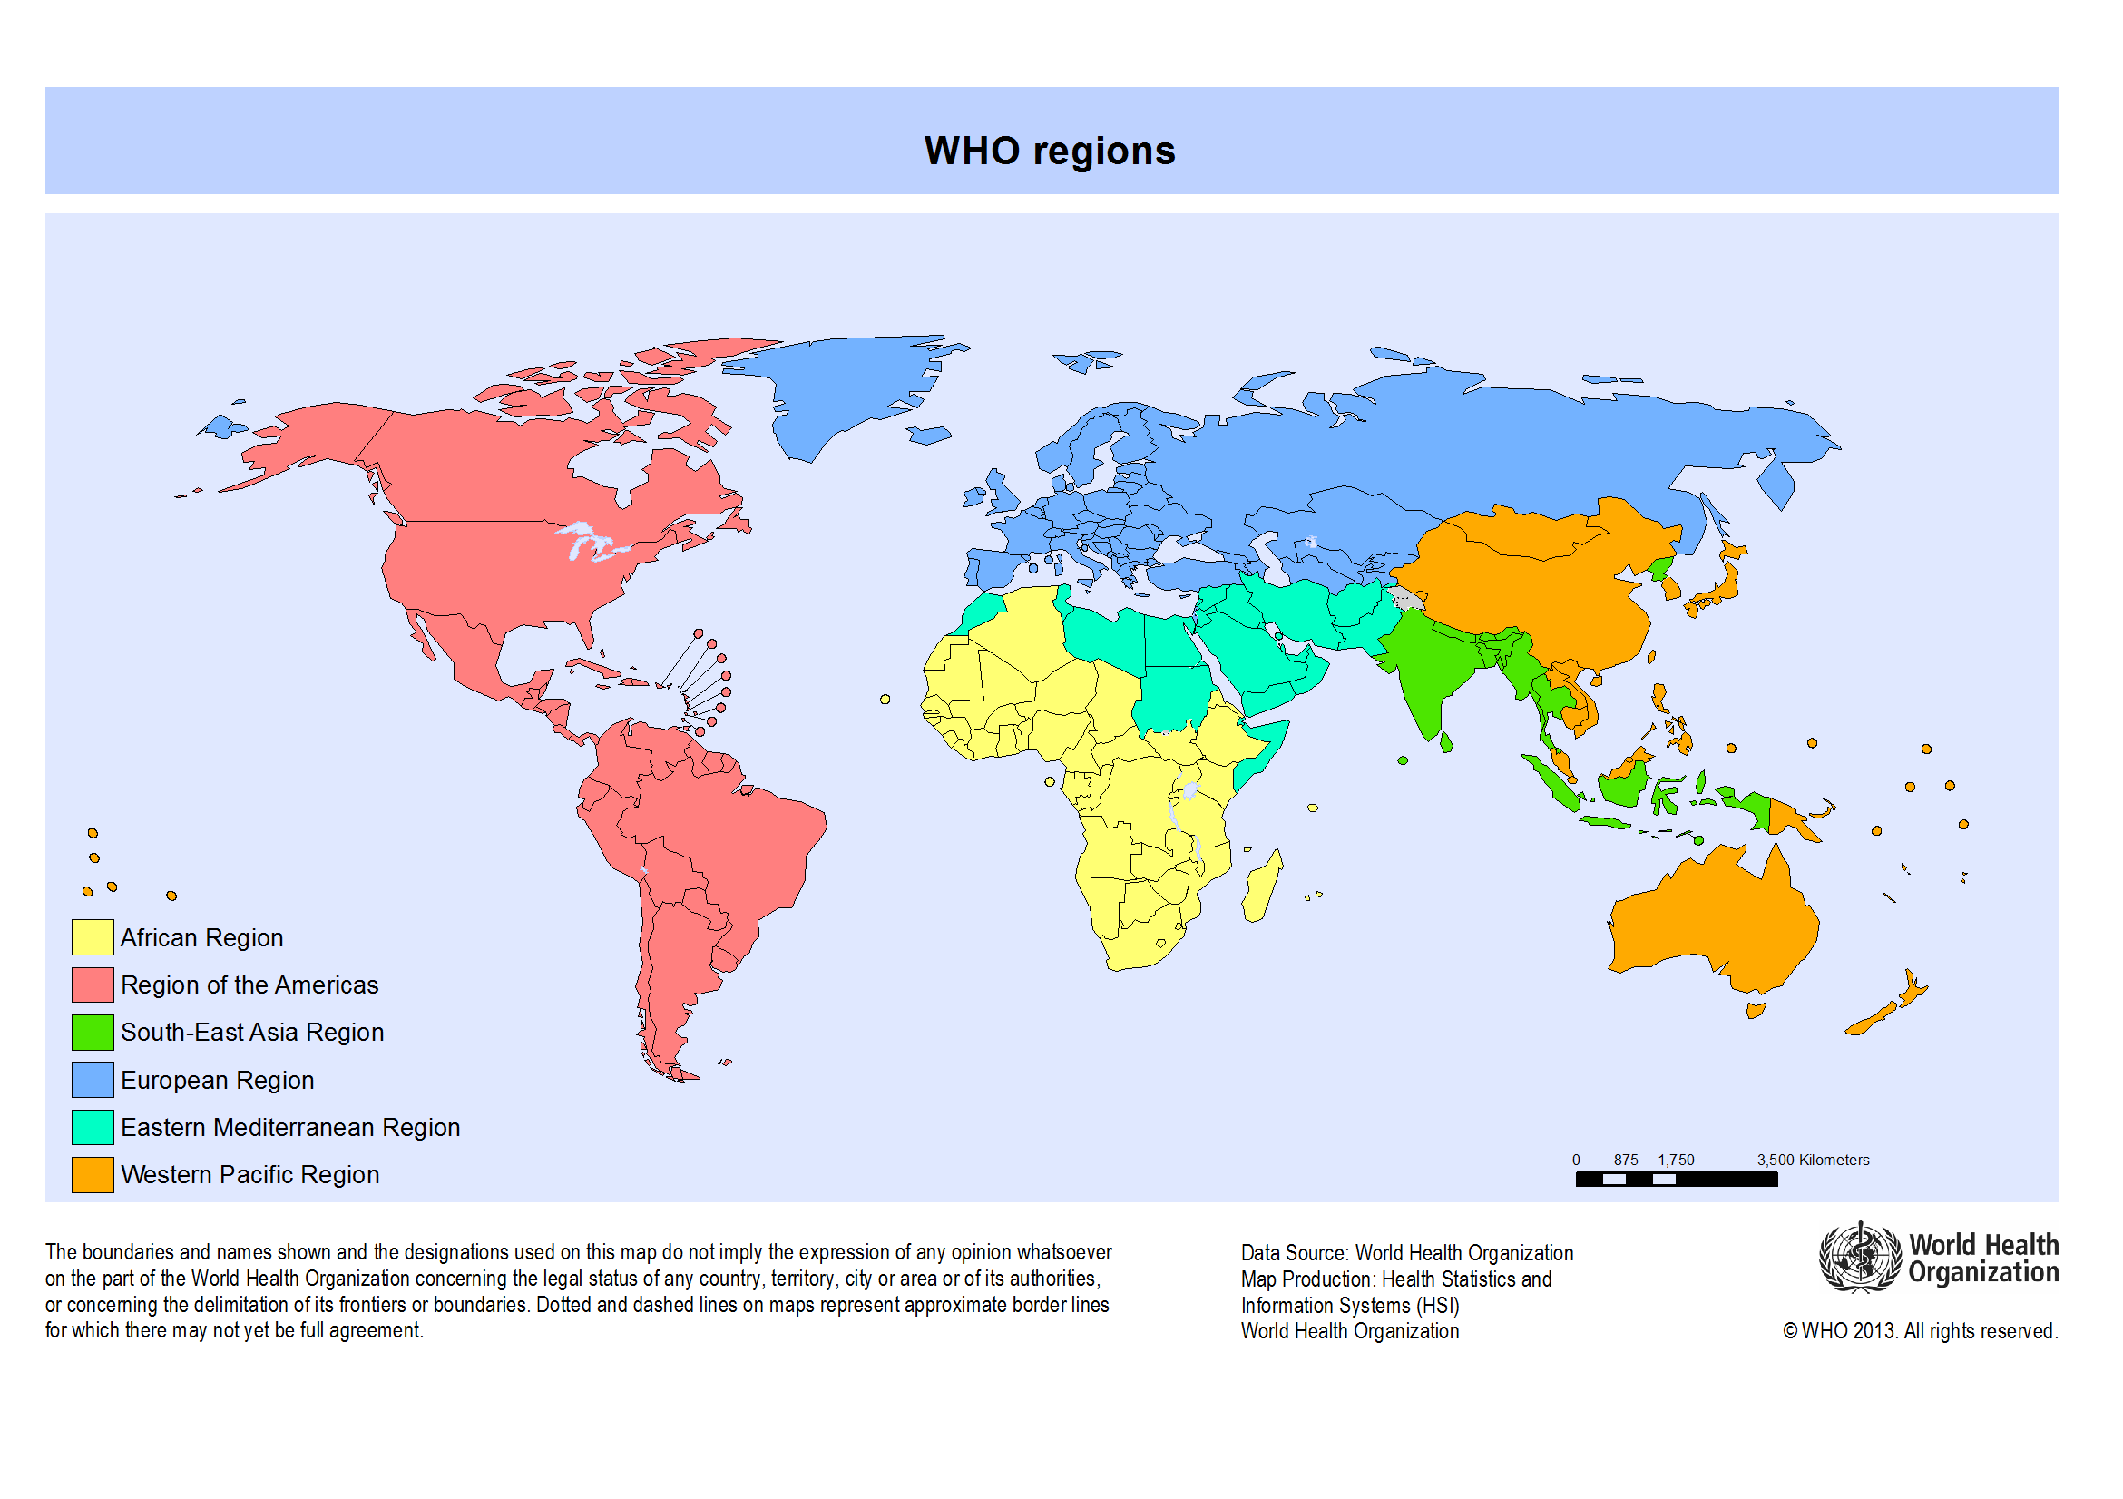
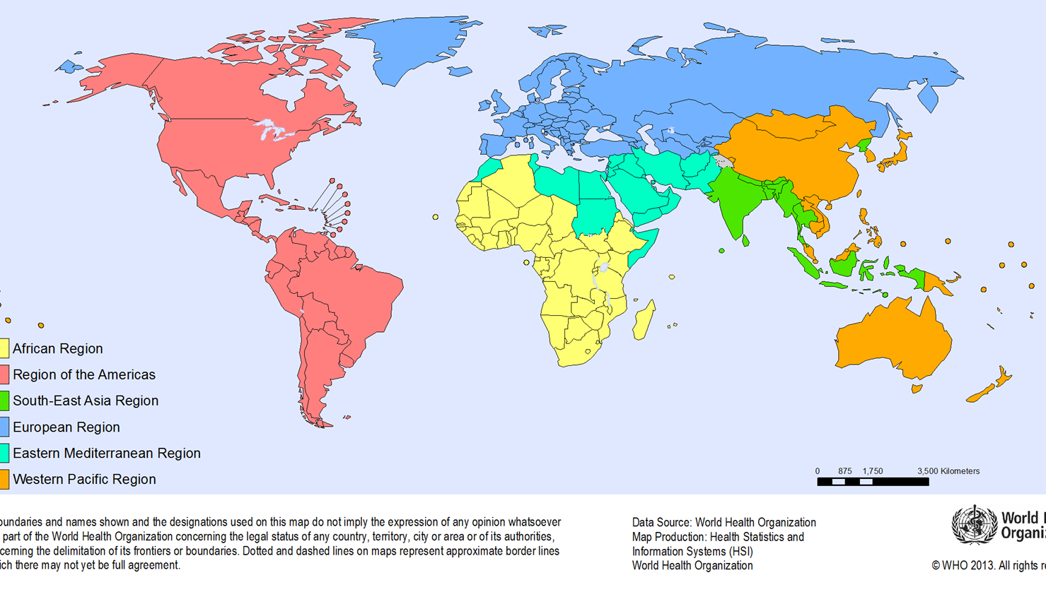
27 countries plan to retain poliovirus type 2 materials in 79 Facilities
EU: 39 (12)
AM: 18 (5)
WP : 16 (5)
EM: 3 (2)
SEA: 2 (2)
AF: 1 (1)
Region of the Americas
African Region
Number in parenthesis represents the number of countries with facilities planning to retain PV2 materials
European Region
Eastern Mediterranean Region
South-East Asia Region
Western Pacific Region
National Authorities for Containment : 24 /27 established
Poliovirus Essential facilities : 6 applications for containment certification (certificate of participation) submitted to GCC
Application endorsed by GCC: 1
Applications on hold: 2
Applications under review: 3
The boundaries and names shown and the designations used on this map do not imply the expression of any opinion whatsoever on the part of the World Health Organization concerning the legal status of any country, territory, city or area or of its authorities, or concerning the delimitation of its frontiers or boundaries. Dotted and dashed lines on maps represent approximate border lines for which there may not yet be full agreement.
18
Data in WHO HQ as of 26 Oct. 2018

Slide 19
Certification of polio eradication
Global Certification Commission: 29 October – 1 November
Certification of the eradication of the wild polio virus will follow a sequential approach with WPV3 eradication being certified ahead of WPV1
The validation of the absence of cVDPVs will only be possible after the total cessation of use of all OPVs
The sequential approach:
WPV type 3 eradication certification (after African region certification)
Certification of WPV1 eradication (~ 3 years after last WPV1 detection)
Validation of the absence of cVDPVs (after global OPV cessation)
19

Slide 20


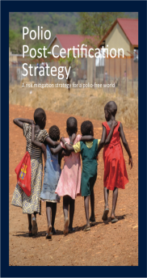

Overview: GPEI Strategy 2019-2023
CERTIFICATION
(GPEI DISSOLVES)
2013
2019
2024
Polio Eradication, Certification, Integration: The Endgame Strategy
GVAP 2.0
Polio Eradication Endgame Strategic Plan & Mid-term Review
Gavi 5.0
WHO IVB Strategy
2019-2023
UNICEF Immunization Strategy
2013-2019
Eradication: Stopping transmission
Certification: Certify eradication and containment of all WPVs and ensure long-term polio security
Integration: Leveraging polio assets and lessons learned to protect populations
Cross-cutting areas: (management, research, budget and finance)
Objective 1: Poliovirus detection and interruption
Objective 2: Immunization systems strengthening and OPV withdrawal
Objective 3: Containment and certification
Objective 4: Legacy Planning
Goal 1: Contain polioviruses
Goal 2: Protect populations
Goal 3: Detect and respond
Global Health Security Agenda
…
GPEI
TRANSITION
POST-GPEI PROGRAMMES

Slide 21
National Update

Slide 22
Key Achievements: India
India has maintained WPV-free status for more than 7 years
Overall AFP surveillance indicators meet global standards
Expansion of environmental surveillance to 41 sites in 8 states
India has successfully switched from tOPV to bOPV in April 2016
Fractional intradermal IPV immunization schedule scaled-up to all states
Substantial reduction in VDPVs type 2 in humans and environment – no VDPV type 2 in AFP case since February 2016 and in env. samples since March 2017
Country maintains capacity to respond to polio outbreaks
evidenced by the rapid response to type 2 VDPV detected in 2016 (post-switch)

Slide 23
WPV-free status maintained for > 7 years
1934
No WPV case since January 2011
1600
P1 wild
P2 wild
P3 wild
* data as on 27 November 2018

Slide 24
Key Recommendations of 27th India Expert Advisory Group (IEAG) on Polio, June 2018
IEAG strongly recommends that India should continue to administer IPV, nationwide since IPV is critical to maintaining India’s polio free status including mitigation of multiple risks of a Type 2 poliovirus outbreak (from importation, silent circulation, continued use of tOPV, containment breach)
IEAG recommends India should maintain its current RI schedule of 2 fIPV doses administered at 6 and 14 weeks
In accordance with current SAGE recommendations - 2 fIPV doses provide superior immunity than 1 full IPV dose
All efforts should be made to achieve high RI fIPV2 coverage, ideally ≥ 90%

Slide 25
Key Recommendations of 27th India Expert Advisory Group (IEAG) on Polio, June 2018
India should conduct 1 NID and 2 SNIDs using bOPV in 2019 and 2020
The scope of SNIDs should target high-risk areas depending on epidemiological data
Results of the pending 2018 sero-prevalence study would be used by IEAG to further guide the scope of the SNIDs in 2020

Slide 26
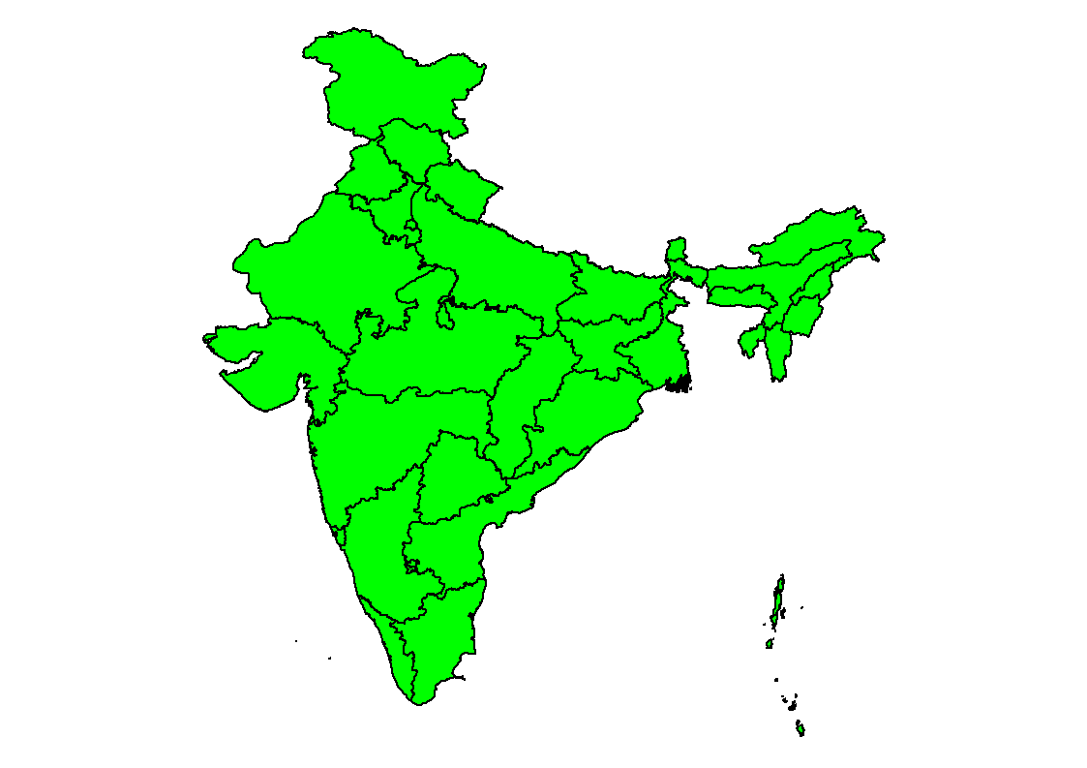
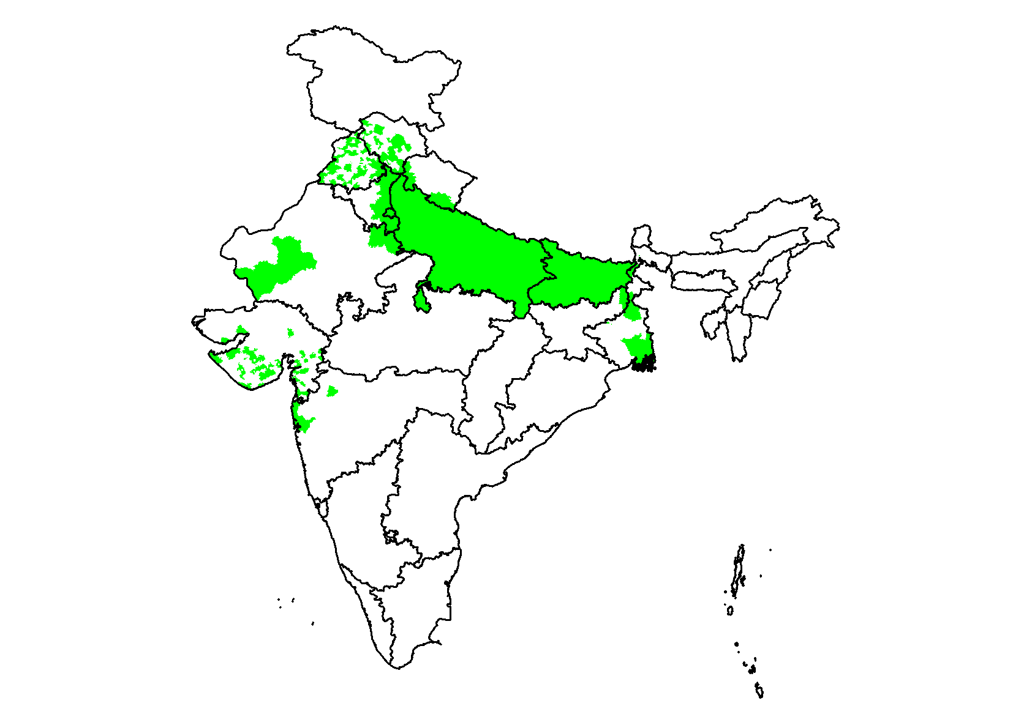
Recommended SIA schedule - India
NID
SNID
SIA with bOPV
2019
2020
Notes:
26
26

Slide 27
Key Recommendations of 27th India Expert Advisory Group (IEAG) on Polio, June 2018
IEAG notes that, while meeting the required standards at the national level, reported NPAFP rates have decreased in some states and are suboptimal in some districts across the country
Surveillance should be strengthened through an increase in the active case searches and a re-sensitization of all Reporting Sites
Great care should be taken to ensure that surveillance quality is maintained to meet requirements of post certification strategy as a part of the polio transition efforts

Slide 28
MONTH WISE AFP CASES 2018*
 | JAN | FEB | MAR | APR | May | June | July | Aug | Sept | Oct | Nov | Dec | Total
GBG | 6 | 2 | 2 | 2 | 7 | 2 | 5 | 8 | 11 | 8 | 2 | 1 | 56
BDR | 1 | 4 | 2 | 1 | 4 | 2 | 3 | 3 | 0 | 0 | 2 | 1 | 23
RCR | 1 | 3 | 0 | 1 | 6 | 4 | 4 | 10 | 3 | 3 | 5 | 3 | 43
YDR | 2 | 0 | 0 | 2 | 2 | 2 | 3 | 3 | 6 | 7 | 0 | 0 | 27
TOTAL | 10 | 9 | 4 | 6 | 19 | 10 | 15 | 24 | 20 | 18 | 9 | 5 | 149
Comparative AFP case reported year wise with Variance
District | 2015 | 2016 | 2017 | 2017, Week No. 50 | 2018, Week No. 50 | Variance
BIDAR | 29 | 39 | 19 | 18 | 22 | 4
KALABURGI | 71 | 79 | 32 | 28 | 56 | 28
RAICHUR | 46 | 42 | 26 | 23 | 43 | 20
YADGIRI | 31 | 29 | 12 | 11 | 27 | 16
Total | 177 | 189 | 89 | 80 | 149 | 68
*Data as of Week No.50 ending of 15/12/2018
No silent block for last 10 yrs & More

Slide 29
Block wise AFP cases & Stool Rate of 2018* Kalaburagi District
 | Afzalpur | Aland | Chincholli | Chittapur | Jewargi | Kalaburagi | Sedam | Total
2016 | 8 | 7 | 8 | 9 | 18 | 21 | 7 | 78
2017 | 5 | 10 | 1 | 5 | 5 | 2 | 5 | 33
2018 | 7 | 16 | 3 | 7 | 7 | 15 | 1 | 56
*Data as of Week No.50 ending of 15/12/2018

Slide 30
Block wise AFP cases & Stool Rate of 2018* Bidar District
 | Aurad | Basavakalyan | Bhalki | Bidar | Humnabad | Total
2016 | 2 | 4 | 7 | 14 | 10 | 37
2017 | 3 | 3 | 5 | 4 | 4 | 19
2018* | 1 | 5 | 5 | 8 | 1 | 20
*Data as of Week No.50, ending of 15/12/2018

Slide 31
AFP Rate for last 3 years
*Data as of Week No.47 ending of 24/11/2018

Slide 32
Key Recommendations of 27th India Expert Advisory Group (IEAG) on Polio, June 2018
IEAG reinforces that outbreak response protocols and preparedness plans should continue to be updated to align with current global guidelines
An outbreak simulation exercise should be conducted on an annual basis to ensure adequate preparedness
GOI has issued directive that all states and districts should revise and update Polio RRT members list

Slide 33
Unprecedented progress but the risks remain….

Slide 34
Current risks to polio eradication in India
Complacency/Lack of focus
Emergence of VDPVs
International importation
Risks
Areas with low population immunity
Gaps in AFP surveillance or delays in detection of WPV
Delayed and/or inadequate response to importation

Slide 35
Current priorities for polio eradication
Maintaining high population immunity
Sustaining sensitive surveillance for detection of polioviruses
Mitigating risk of importation – cross border vaccination
Implementing emergency preparedness & response plans
Building on polio legacy to strengthen routine immunization
Polio end game strategy development & planning

Slide 36
District Level Strategies
Ensure highest level of administrative & political involvement
Continue focus on high risk blocks
Focus on vulnerable/underserved populations
Intensify IEC activities during SIAs
Campaign monitoring & ensure feedback mechanism at district and sub-district levels
Ensure high quality AFP surveillance
Continue vaccination of international travellers
Emergency Preparedness and Response
36

Slide 37
Karnataka Update

Slide 38
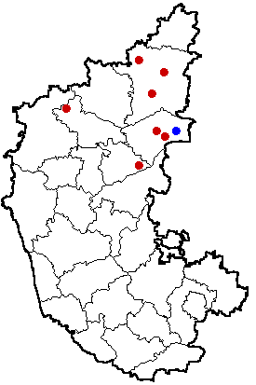
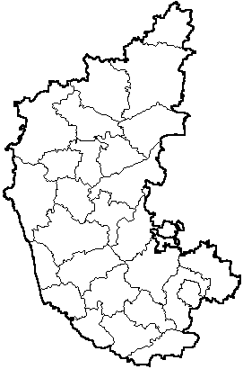
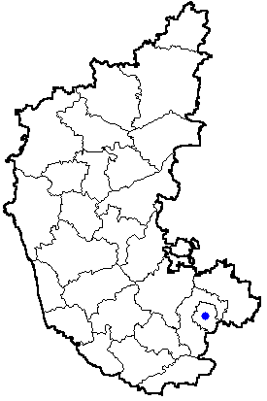
1998
1999
2000
2001 , 2002
2003
71 Cases
21 Cases
8 Cases
0 Case
36 Cases
Wild Polio Cases - Karnataka
2004
2005, 2006
2007
2008-2018
1 Case
0 Case
Last case in State
0 Case

Slide 39
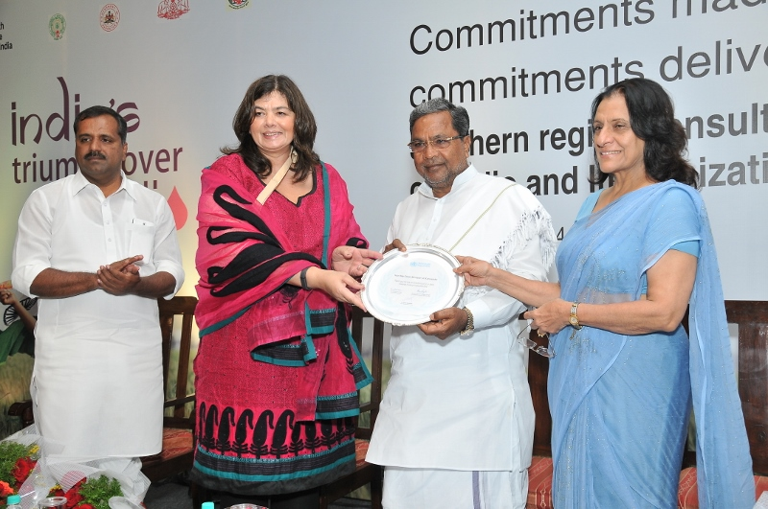
August 19, 2014:
Karnataka’s efforts in Polio Free India recognized by WHO

Slide 40
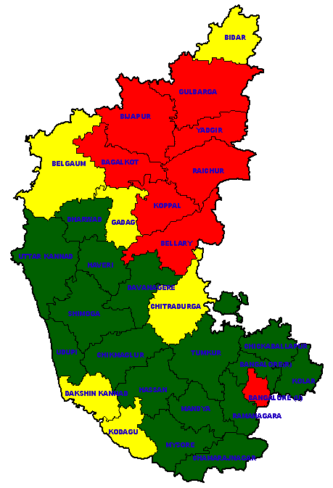
District wise Risk Assessment – Karnataka for Polio & RI
High Risk
Medium Risk
Low Risk
8 Districts are at high risk
Risk assessment criteria as per GOI scoring system
As of 30th June 2012
Notes:
40

Slide 41
Classification of AFP cases and key surveillance indicators
Karnataka State | 2015 | 2016 | 2017 | 2018*
AFP Cases | 948 | 944 | 662 | 712
Number of polio cases | 0 | 0 | 0 | 0
VDPV | 0 | 0 | 0 | 0
Number of compatible cases | 1 | 0 | 1 | 0
Discarded (Non-Polio) | 947 | 944 | 659 | 611
AFP rate | 5.57 | 5.44 | 3.76 | 4.43
Non-polio AFP rate | 5.56 | 5.44 | 3.75 | 3.8
% Stool collected within 14 days of onset | 85% | 81% | 82% | 83%
% Notification within 10 days of onset | 87% | 85% | 87% | 88%
% Investigation within 48 hrs of notification | 89% | 89% | 87% | 87%
*Data as of Week No.47, ending of 24/11/2018

Slide 42
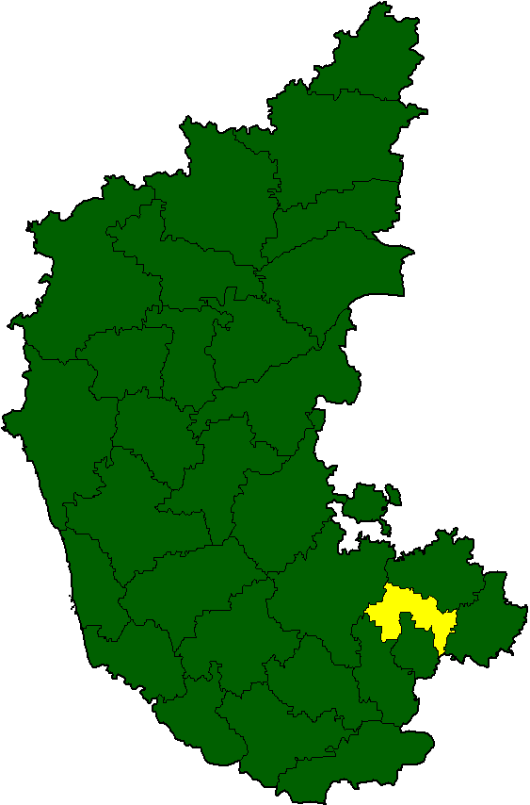
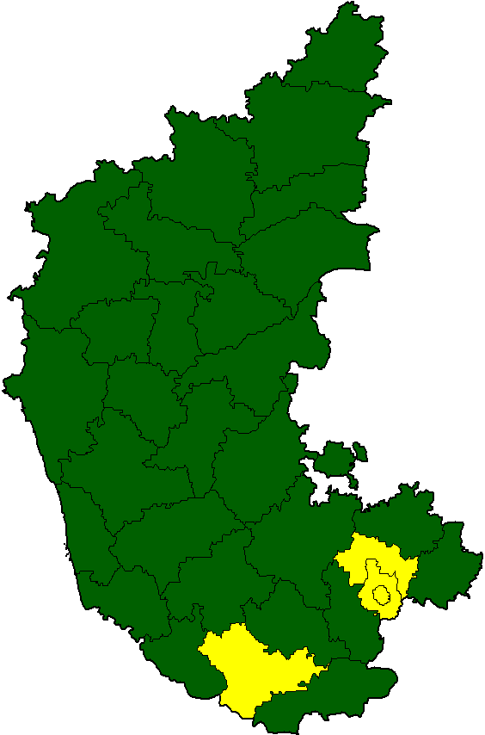
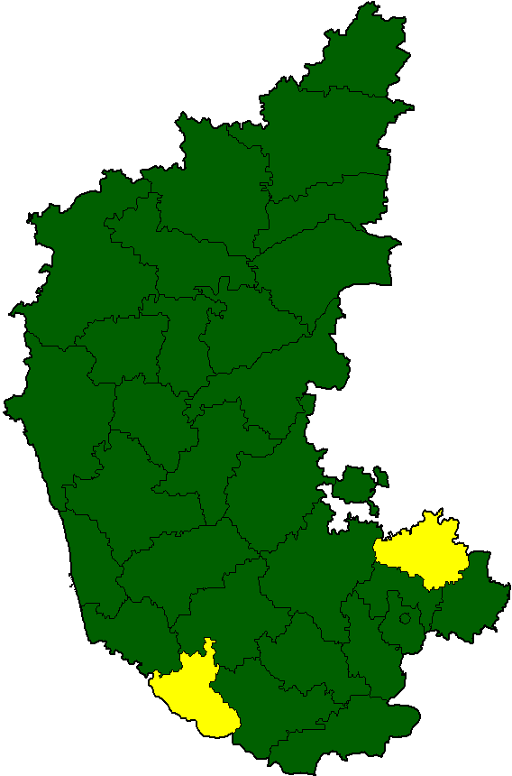
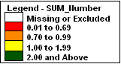
Indicator – AFP Rate
2016
2017
2018*
5.45
3.76
4.43
*Data as of Week No.47, ending of 24/11/2018

Slide 43
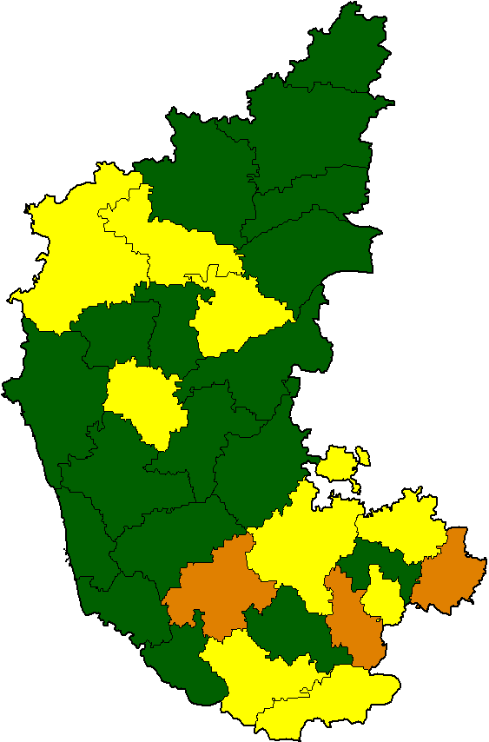
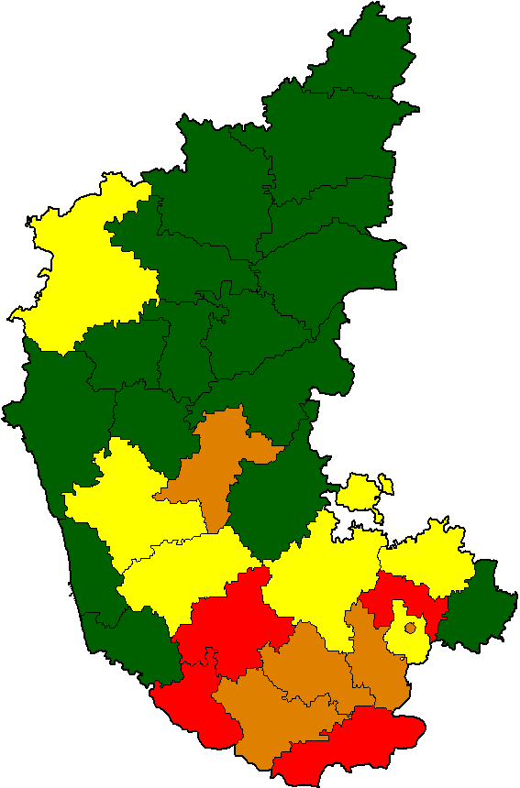
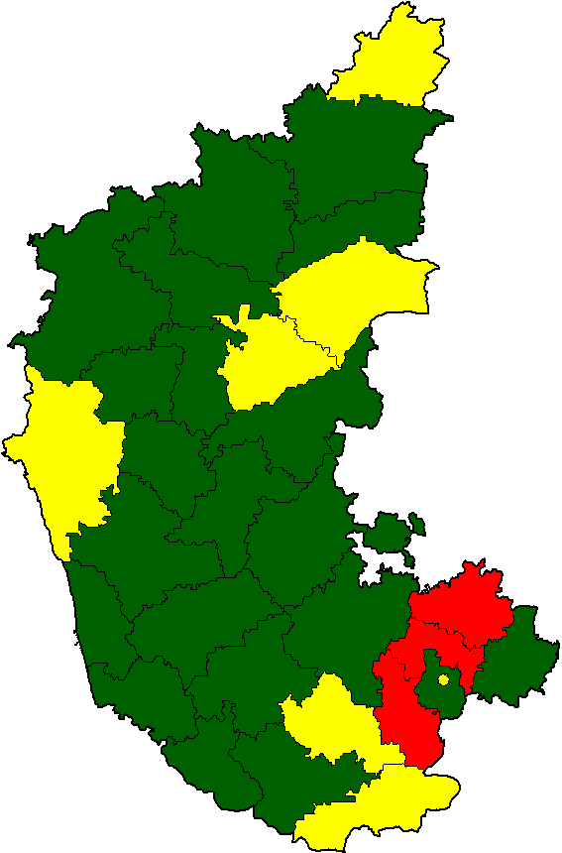
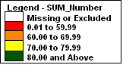
Stool collected within 14 days of onset
2016
2017
2018*
82%
82%
83%
*Data as of Week No.47, ending of 24/11/2018

Slide 44
NIDs – 2018 Performance Review

Slide 45
March 2018 NID Coverage Report
Name of Block | Estimated Number of Children Below 5 Years | Booth Coverage | Total Children Vaccinated | Percentage (%)
 |  | Total Children Vaccinated in booths
Shahapur | 54624 | 45284 | 45774 | 83.80
Shorapur | 68035 | 46431 | 50037 | 73.55
Yadgir | 66555 | 50432 | 51788 | 77.81
District Total | 189214 | 142147 | 147599 | 78.01
Name of Block | Estimated Number of Children Below 5 Years | Booth Coverage | Total Houses Planned | House to House Coverage | Total Children Vaccinated | Percentage (%)
 |  | Total Children Vaccinated in booths |  | Total houses visited by teams
Shahapur | 54624 | 45284 | 69753 | 71832 | 54520 | 99.81
Shorapur | 68035 | 46431 | 76428 | 75657 | 67407 | 99.08
Yadgir | 66555 | 50432 | 75653 | 77958 | 65700 | 98.72
District Total | 189214 | 142147 | 221834 | 225447 | 187627 | 99.16

Slide 46
HRA Reported coverage
Name of Block | Migratory HR Areas |  |  |  |  |  |  |  |  |  | Settled HR Areas
 | Slums |  | Nomads |  | Brick Kiln |  | Construction Sites |  | Other Migratory Sites |  | No. of sites / areas visited | No. of children vaccinated
 | No. of sites / areas visited | No. of children vaccinated | No. of sites / areas visited | No. of children vaccinated | No. of sites / areas visited | No. of children vaccinated | No. of sites / areas visited | No. of children vaccinated | No. of sites / areas visited | No. of children vaccinated
Shahapur | 17 | 82 | 5 | 373 | 6 | 0 | 0 | 110 | 17 | 117 | 74 | 9367
Shorapur | 0 | 0 | 1 | 0 | 1 | 0 | 0 | 0 | 0 | 0 | 114 | 664
Yadgir | 27 | 756 | 3 | 5 | 6 | 91 | 0 | 0 | 2 | 39 | 82 | 1078
District Total | 44 | 838 | 9 | 378 | 13 | 91 | 0 | 110 | 19 | 156 | 270 | 11109

Slide 47
Booth, H-t-H & Transit team + Mobile Coverage
 | Jan-18 | Mar-18
Booth coverage | 5560251 | 5544761
HtoH coverage | 757029 | 761330
Transit / Mobile Team Coverage | 379621 | 371232
Total Coverage | 6696901 | 6677323
Percentage | 104.20% | 103.94%

Slide 48
March 2018 NID- Monitoring Report
False ‘P ‘
Block | Total Houses Visited | Total False P Houses Detected | %
Yadgir | 81 | 0 | 0.00
Shorapur | 169 | 0 | 0.00
Shahapur | 166 | 10 | 6.02
Total | 416 | 10 | 2.40
HRA Monitoring Report
Block | Total Sites Visited | Total Children Checked | Total Unvaccinated <5 Yrs Found | %
Yadgir | 24 | 214 | 2 | 0.93
Shahapur | 31 | 140 | 6 | 4.29
Shorapur | 15 | 86 | 3 | 3.49
Total | 70 | 440 | 11 | 2.50
End of the Round Survey
Block | Children < 2 Yrs Checked | Total Children Un-Immunized < 2 Yrs | Percentage | Children between 2 - 5 Yrs Checked | Total Children Un-Immunized between 2 - 5 Yrs | Percentage | Total children checked | Total children unimmunized | Total percent
Yadgir | 285 | 2 | 0.70 | 340 | 8 | 2.35 | 625 | 10 | 1.60
Shahapur | 92 | 0 | 0.00 | 665 | 12 | 1.80 | 757 | 12 | 1.59
Shorapur | 97 | 0 | 0.00 | 353 | 0 | 0.00 | 450 | 0 | 0.00
TOTAL | 474 | 2 | 0.42 | 1358 | 20 | 1.47 | 1832 | 22 | 1.20

Slide 49
March 2018 Booth Day Coverage Report
Name of Block | Estimated Number of Children Below 5 Years | Booth Coverage | No.of Children vaccinated at transit pionts/mela sites/bazaars | Total Children Vaccinated | Percentage (%)
 |  | Total Children Vaccinated in booths
Afzalpur | 24480 | 20530 | 1273 | 21803 | 89.06
Aland | 38077 | 30392 | 1710 | 32102 | 84.31
Chincholi | 28253 | 22721 | 2469 | 25190 | 89.16
Chittapur | 45034 | 36888 | 3146 | 40034 | 88.90
Kalaburagi {R} | 32124 | 27896 | 1342 | 29238 | 91.02
Kalaburagi (U) | 61394 | 51951 | 4291 | 56242 | 91.61
Jewargi | 33348 | 28395 | 738 | 29133 | 87.36
Sedam | 24298 | 20029 | 1371 | 21400 | 88.07
Total | 287008 | 238802 | 16340 | 255142 | 88.90

Slide 50
Overall Coverage in March 2018 Round
Name of Block | Estimated Number of Children Below 5 Years | Booth Coverage | House to House Coverage |  | No.of Children vaccinated at transit pionts/mela sites/bazaars | Total Children Vaccinated | Percentage (%)
 |  | Total Children Vaccinated in booths | Total houses visited by teams | No. of children vaccinated in houses by teams
Afzalpur | 24480 | 48216 | 16797 | 1489 | 4477 | 24015 | 98.10
Aland | 38077 | 73720 | 26329 | 2642 | 6407 | 35429 | 93.05
Chincholi | 28253 | 57936 | 21618 | 1556 | 6064 | 27465 | 97.21
Chittapur | 45034 | 90420 | 34042 | 3968 | 10631 | 45197 | 100.36
Kalaburagi {R} | 32124 | 47621 | 41164 | 2221 | 3787 | 32529 | 101.26
Kalaburagi (U) | 61394 | 98404 | 98779 | 12038 | 16120 | 75007 | 122.17
Jewargi | 33348 | 28395 | 58309 | 5589 | 1538 | 36022 | 108.02
Sedam | 24298 | 20029 | 48449 | 3138 | 2264 | 26065 | 107.27
Total | 287008 | 238802 | 552373 | 48904 | 28642 | 326340 | 113.70

Slide 51
HRA Reported coverage
Name of Block | Migratory HR Areas |  |  |  |  |  |  |  |  |  | Settled HR Areas |  | Total Sites Visited | Total Children Covered
 | Slums |  | Nomads |  | Brick Kiln |  | Construction Sites |  | Other Migratory Sites |  | No. of sites / areas visited | No. of children vaccinated
 | No. of sites / areas visited | No. of children vaccinated | No. of sites / areas visited | No. of children vaccinated | No. of sites / areas visited | No. of children vaccinated | No. of sites / areas visited | No. of children vaccinated | No. of sites / areas visited | No. of children vaccinated
Afzalpur | 1 | 224 | 13 | 111 | 13 | 17 | 2 | 0 | 54 | 232 | 891 | 7703 | 974 | 8287
Aland | 1 | 6 | 1 | 3 | 1 | 5 | 4 | 52 | 21 | 283 | 182 | 5726 | 210 | 6075
Chincholi | 0 | 0 | 2 | 10 | 0 | 0 | 2 | 32 | 0 | 0 | 128 | 9365 | 132 | 9407
Chittapur | 0 | 0 | 5 | 17 | 2 | 0 | 0 | 0 | 4 | 8 | 207 | 8394 | 218 | 8419
Kalaburagi {R} | 0 | 0 | 3 | 2 | 72 | 427 | 6 | 7 | 106 | 161 | 326 | 4485 | 513 | 5082
Kalaburagi (U) | 0 | 0 | 18 | 251 | 197 | 480 | 17 | 175 | 0 | 0 | 76 | 9343 | 308 | 10249
Jewargi | 1 | 8 | 9 | 42 | 3 | 7 | 0 | 0 | 63 | 301 | 28 | 1690 | 104 | 2048
Sedam | 0 | 7 | 7 | 55 | 2 | 2 | 1 | 25 | 1 | 10 | 62 | 5054 | 73 | 5153
Total | 3 | 245 | 58 | 491 | 290 | 938 | 32 | 291 | 249 | 995 | 1900 | 51760 | 2532 | 54720

Slide 52
March 2018 NID- Monitoring Report
False ‘P’
Block | Total Houses Visited | Total False P Houses Detected | %
Afzalpur | 120 | 0 | 0.00
Aland | 110 | 1 | 0.91
Chittapur | 95 | 0 | 0.00
Sedam | 87 | 1 | 1.15
Jewargi | 20 | 0 | 0.00
Gulbarga | 20 | 0 | 0.00
Total | 452 | 2 | 0.44
Migratory Sites Monitoring Report
Block | Total Sites Visited | Total Children Checked | Total Unvaccinated <5 Yrs Found | %
Afzalpur | 29 | 135 | 1 | 0.74
Aland | 21 | 111 | 0 | 0.00
Chittapur | 2 | 18 | 0 | 0.00
Sedam | 2 | 7 | 0 | 0.00
Jewargi | 10 | 70 | 0 | 0.00
Gulbarga | 12 | 98 | 3 | 3.06
Total | 76 | 439 | 4 | 0.91

Slide 53
End of the round Survey
Block | Children < 2 Yrs Checked | Total Children Un-Immunized < 2 Yrs | Percentage | Children between 2 - 5 Yrs Checked | Total Children Un-Immunized between 2 - 5 Yrs | Percentage | Total children checked | Total childrenunimmunized | Total percent
Jewargi | 26 | 0 | 0.00 | 33 | 0 | 0.00 | 59 | 0 | 0.00
Sedam | 21 | 0 | 0.00 | 50 | 0 | 0.00 | 71 | 0 | 0.00
Chittapur | 44 | 0 | 0.00 | 280 | 0 | 0.00 | 324 | 0 | 0.00
Afzalpur | 63 | 0 | 0.00 | 112 | 1 | 0.89 | 175 | 1 | 0.57
Gulbarga | 201 | 1 | 0.50 | 537 | 2 | 0.37 | 738 | 3 | 0.41
TOTAL | 355 | 1 | 0.28 | 1012 | 3 | 0.30 | 1367 | 4 | 0.29

Slide 54
March 2018 NID Booth Coverage Report - Bidar
Name of Block | Estimated Number of Children Below 5 Years | Booth Coverage | No.of Children vaccinated at transit pionts/mela sites/bazaars | Total Children Vaccinated | Percentage (%)
 |  | Total Children Vaccinated in booths
Aurad | 27487 | 22167 | 1351 | 23662 | 86.08
Basvakalyan | 40352 | 36144 | 1044 | 37243 | 92.30
Bidar | 47299 | 35730 | 3846 | 39689 | 83.91
Bhalki | 27813 | 22270 | 2164 | 24500 | 88.09
Humnabad | 31486 | 26765 | 1901 | 28815 | 91.52
District Total | 174437 | 143076 | 10306 | 153909 | 88.23

Slide 55
Overall Coverage March 2018 NID Report
Name of Block | Estimated Number of Children Below 5 Years | Booth Coverage |  | House to House Coverage |  | No.of Children vaccinated at transit pionts/mela sites/bazaars | Total Children Vaccinated | Percentage (%)
 |  | Total Children Vaccinated in booths | Total houses Planned | Total houses visited by teams | No. of children vaccinated in houses by teams
Aurad | 27487 | 22167 | 51830 | 51401 | 3102 | 2164 | 27898 | 101.50
Basvakalyan | 40352 | 36144 | 93868 | 64957 | 3798 | 1779 | 42682 | 105.77
Bidar | 47299 | 35730 | 53575 | 95002 | 13595 | 6661 | 58560 | 123.81
Bhalki | 27813 | 22270 | 63592 | 53539 | 3783 | 3512 | 30548 | 109.83
Humnabad | 31486 | 26765 | 58731 | 59393 | 4589 | 2191 | 34455 | 109.43
District Total | 174437 | 143076 | 321596 | 324292 | 28867 | 16307 | 194143 | 111.30

Slide 56
HRA Reported coverage - Bidar
Name of Block | Migratory HR Areas
 | Slums |  |  | Nomads |  |  | Brick Kiln |  |  | Construction Sites |  |  | Other Migratory Sites
 | No. of sites / areas visited | No. of households | No. of children vaccinated | No. of sites / areas visited | No. of households | No. of children vaccinated | No. of sites / areas visited | No. of households | No. of children vaccinated | No. of sites / areas visited | No. of households | No. of children vaccinated | No. of sites / areas visited | No. of households | No. of children vaccinated
Aurad | 0 | 0 | 0 | 1 | 4 | 0 | 2 | 28 | 36 | 1 | 1 | 2 | 1 | 16 | 0
Basavakalyan | 0 | 0 | 0 | 2 | 8 | 8 | 4 | 46 | 34 | 0 | 0 | 0 | 34 | 262 | 181
Bidar | 1 | 123 | 66 | 2 | 0 | 50 | 10 | 77 | 41 | 12 | 294 | 97 | 54 | 484 | 245
Bhalki | 3 | 205 | 67 | 4 | 9 | 58 | 6 | 46 | 23 | 1 | 0 | 70 | 57 | 303 | 345
Humnabad | 4 | 0 | 8 | 2 | 0 | 22 | 4 | 38 | 42 | 1 | 0 | 3 | 33 | 38 | 102
Total | 8 | 328 | 141 | 11 | 21 | 138 | 26 | 235 | 176 | 15 | 295 | 172 | 179 | 1103 | 873
Name of Block | Settled HR Areas |  |  | Total sites Visted | Total No. of households | Total No. of Children
 | No. of sites / areas visited | No. of households | No. of children vaccinated
Aurad | 153 | 4228 | 1849 | 158 | 4277 | 1887
Basavakalyan | 136 | 26407 | 17760 | 176 | 26723 | 17983
Bidar | 79 | 9047 | 3934 | 158 | 10025 | 4433
Bhalki | 162 | 5619 | 17735 | 233 | 6182 | 18298
Humnabad | 85 | 8558 | 2763 | 129 | 8634 | 2940
Total | 615 | 53859 | 44041 | 854 | 55841 | 45541

Slide 57
Monitoring Feedback
False ‘P’
Block | Total Houses Visited | Total False P Houses Detected | %
Bidar | 70 | 2 | 2.86
Humnabad | 20 | 0 | 0.00
Basavakalyan | 60 | 0 | 0.00
Bhalki | 50 | 1 | 2.00
Total | 200 | 3 | 1.50
HRA Monitoring
Block | Total Sites Visited | Total Children Checked | Total Unvaccinated <5 Yrs Found | %
Bidar | 10 | 59 | 0 | 0.00
Humnabad | 3 | 39 | 1 | 2.56
Basavakalyan | 4 | 31 | 2 | 6.45
Bhalki | 9 | 46 | 1 | 2.17
Total | 26 | 175 | 4 | 2.29
Post Activity Survey
Sl. No. | Block | Children < 2 Yrs Checked | Total Children Un-Immunized < 2 Yrs | Percentage | Children between 2 - 5 Yrs Checked | Total Children Un-Immunized between 2 - 5 Yrs | Percentage | Total children checked | Total children unimmunized | Total percent
1 | Bhalki | 2 | 0 | 0.00 | 3 | 0 | 0.00 | 5 | 0 | 0.00
2 | Humnabad | 3 | 0 | 0.00 | 6 | 0 | 0.00 | 9 | 0 | 0.00
3 | Basavakalyan | 3 | 0 | 0.00 | 9 | 0 | 0.00 | 12 | 0 | 0.00
4 | Aurad | 29 | 0 | 0.00 | 22 | 0 | 0.00 | 51 | 0 | 0.00
5 | Bidar | 63 | 0 | 0.00 | 266 | 0 | 0.00 | 329 | 0 | 0.00
TOTAL |  | 100 | 0 | 0.00 | 306 | 0 | 0.00 | 406 | 0 | 0.00

Slide 58
% OF ‘X’ REMAINING + FALSE ‘P’ HOUSES = MISSED HOUSES
X Marked Houses Information | Apr-17 (I round) | Apr-17 (II round) | Jan-18 (I round) | Mar-18 (II round)
Total houses visited by team | 14387690 | 14358742 | 14387476 | 14742346
% X houses generated | 334214 | 319549.08 | 324582 | 285273
 | 2.32 | 2.23 | 2.26 | 1.94
% X houses converted to P | 76129 | 88113 | 76835 | 67423
 | 22.78 | 27.57 | 23.67 | 23.63
% X houses left at the end of activity | 258823 | 231442 | 247747 | 217850
 | 1.80 | 1.61 | 1.72 | 1.48
Total Houses Visited (Monitors) | 12042 | 11855 | 14064 | 13763
Total False P Houses Detected | 239 | 230 | 145 | 115
% false P houses found by Monitors | 1.98% | 1.94% | 1.03% | 0.84%
% total houses missed | 3.78% | 3.55% | 2.75% | 2.31%

Slide 59
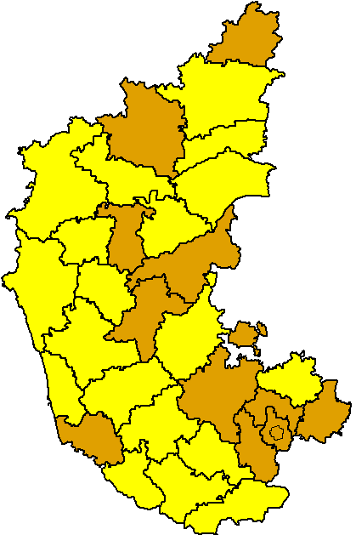
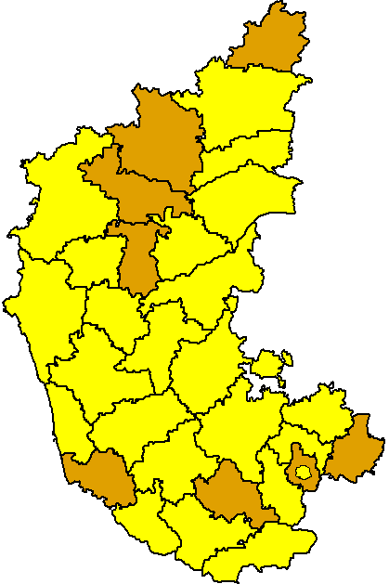
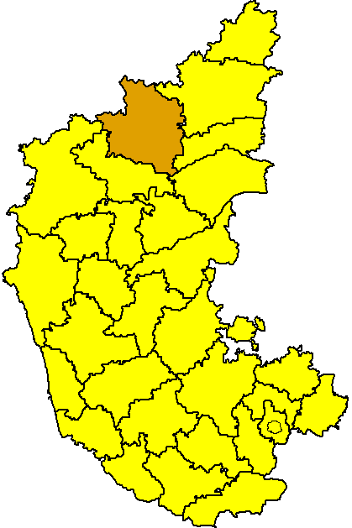
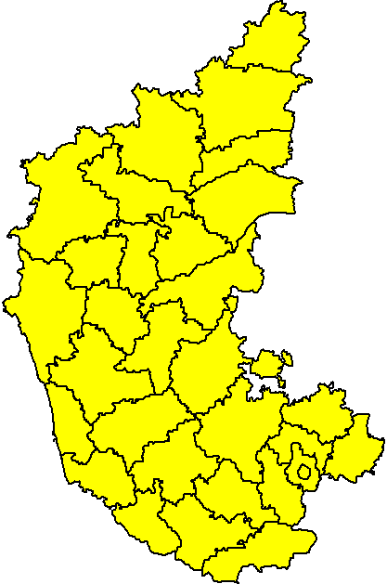
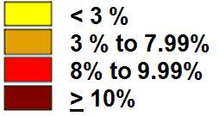
False P houses detected by monitors
Apr’17 (I round)
Apr’17 (II round)
Jan 2018*
Mar 2018*
2.63%
2.28%
1.03%
0.84%
* Provisional data

Slide 60
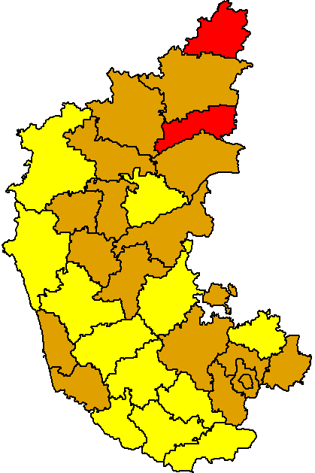
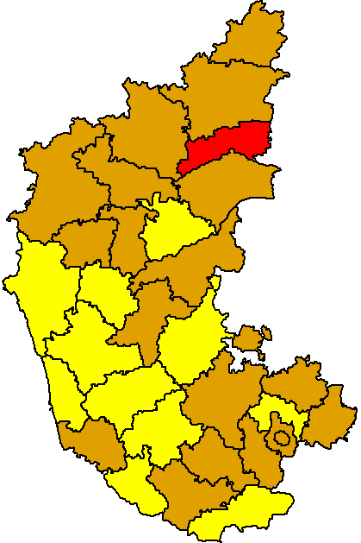
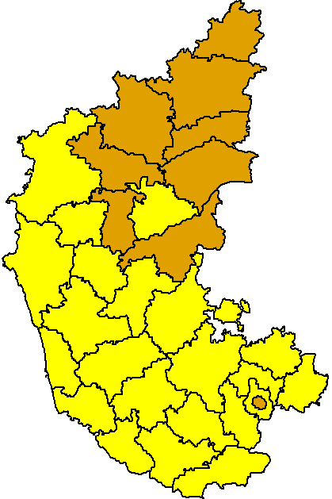
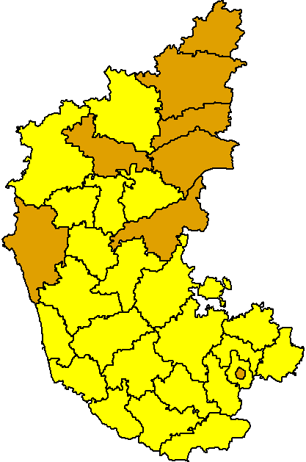
Percent total houses missed, Karnataka
Apr’17 (I round)
Apr’17 (II round)
Jan 2018*
Mar 2018*
4.43%
3.18%
2.75%
2.31%
* Provisional data

Slide 61
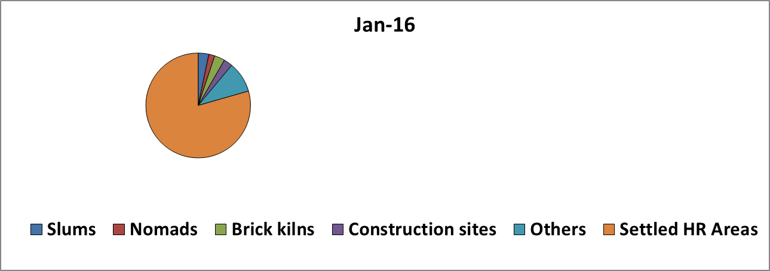
NID Coverage <5yrs children at HR areas
N-518566
N-484446
N-632483
N-632483
 | Apr-17 (I round) |  | Apr-17 (II round) |  | Jan-18 |  | Mar-18
Slums | 18979 | 4% | 15298 | 3% | 24172 | 4% | 45062 | 7%
Nomads | 5395 | 1% | 6445 | 1% | 4997 | 1% | 6288 | 1%
Brick kilns | 13210 | 3% | 10483 | 2% | 15933 | 3% | 11573 | 2%
Construction sites | 13380 | 3% | 12092 | 2% | 13495 | 2% | 9154 | 1%
Others | 16933 | 3% | 19016 | 4% | 30019 | 5% | 17159 | 3%
Settled HR Areas | 450669 | 87% | 421112 | 87% | 543867 | 86% | 551961 | 86%
Total | 518566 |  | 484446 |  | 632483 |  | 641197

Slide 62
% children found unimmunized in migratory population sites
Mar-18 NID round | No. of sites | No of Children < 5 yrs checked | No of unvaccinated children < 5 yrs found | %
M1 | 207 | 1922 | 58 | 3.02
M2 | 218 | 1508 | 61 | 4.05
M3 | 234 | 1369 | 20 | 1.46
M4 | 132 | 693 | 11 | 1.59
M5 | 253 | 2240 | 49 | 2.19
Total | 1044 | 7732 | 199 | 2.57
Source: Consolidated from SIA monitoring form

Slide 63
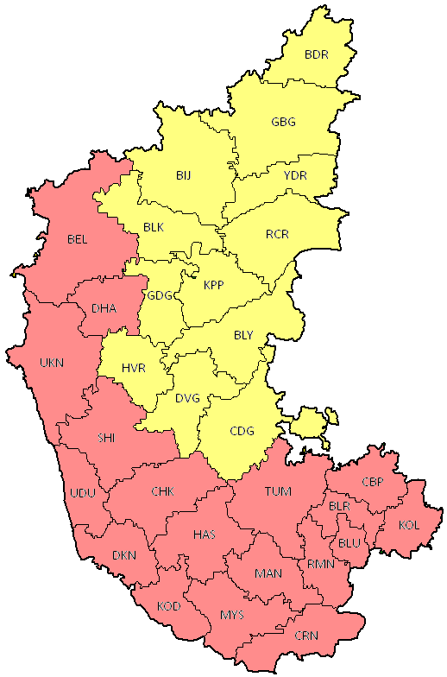
Karnataka State NID
3rd February 2019
North Karnataka
(Since 2003-04 Polio Outbreak)
Booth day +
3 days House to House in all areas
South Karnataka
Booth day +
2 days H-t-H in Rural &
3 day H-t-H in Urban areas

Slide 64
Importance of High Risk areas & HRA Validation

Slide 65
Mitigating Risks to Polio Eradication
Emergency Preparedness and Response Plan Key actions to be undertaken
Identify and consistently cover areas and populations at high risk for importation and spread of poliovirus
High quality Pulse polio supplementary immunization campaigns
Intensify Routine Immunization
Intensify AFP surveillance particularly amongst migrants

Slide 66
Focus area for NID
Focus on coverage and monitoring of migratory and settled High Risk Areas
Focus to continue on coverage and quality of activities in North Karnataka
Focus needed on Urban areas, Unserved and Underserved populations

Slide 67
What are high risk areas?
Areas at a higher risk of wild polio virus transmission & Other vaccine preventable diseases
Migratory
Responsible for importations of WPVs
Capable of sustaining low level transmission and moving virus back and forth
Poorly covered in RI & SIAs
Non migratory or settled population
Risk of WPV transmission and spread following importation high
Malegaon, Murshidabad & Pakur etc
Poor RI coverage with variable SIA coverage

Slide 68
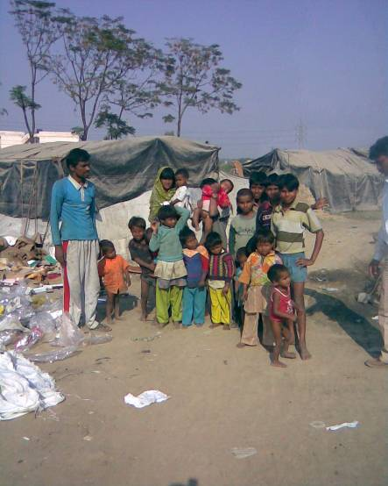
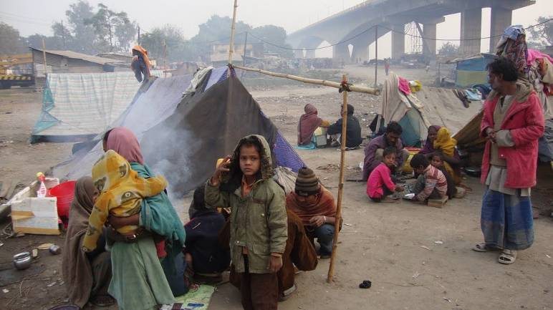
Migratory High Risk Areas/ Populations
M-1. Slums
Urban/peri-urban/ Agricultural & Industrial slums
M-2. Nomads
Communities who travel from place to place for livelihoods setting up temporary home (dera’s) on empty tracks of land near railway stations, market places etc.
Often work as blacksmiths, basket weavers, puppeteers, acrobats, fortune-tellers, singers and dancers.

Slide 69
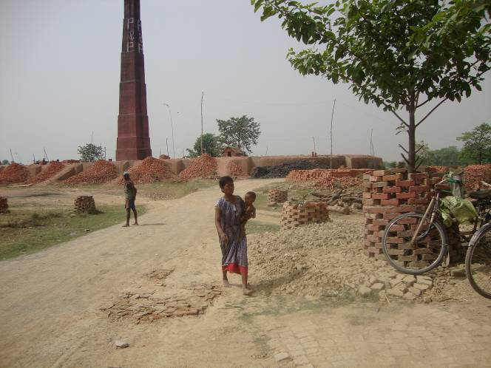
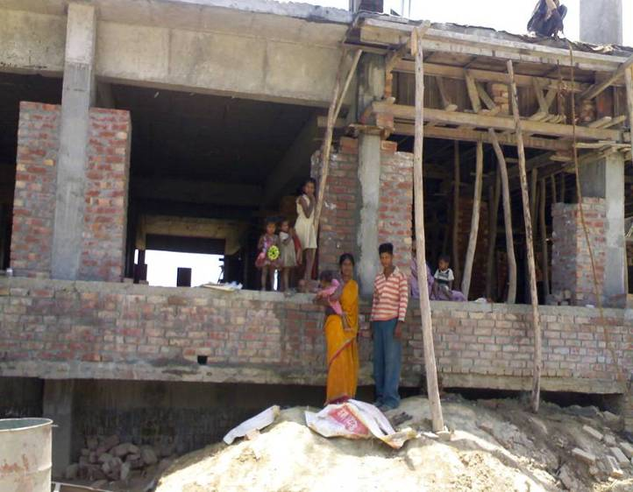
Migratory High Risk Areas/ Populations
M-3. Brick Kilns
Children at the labor camps in the brick kilns as well as the “pather” fields where the bricks are prepared.
M-4. Construction Sites
Children in labor camps at or nearby construction sites, in brick sheds, and in under construction buildings
M-5. Others
Migratory fishing communities
River islands

Slide 70
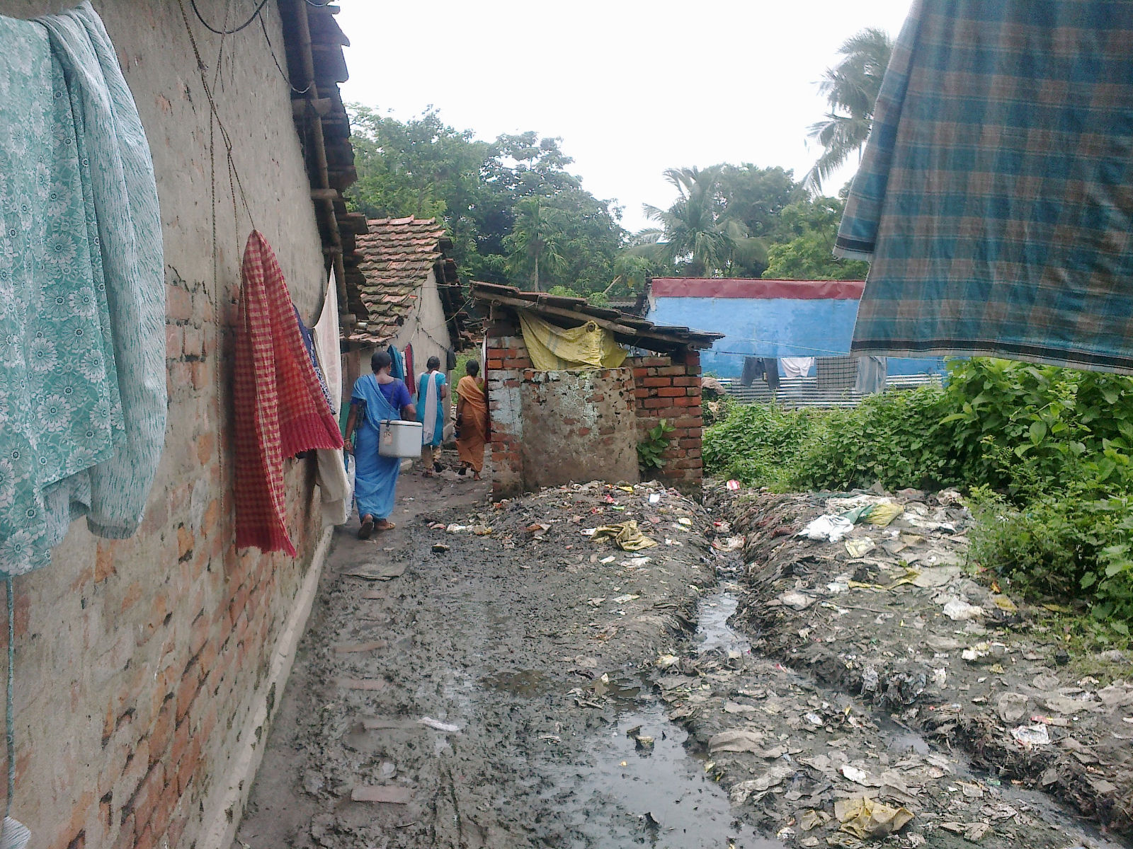
Non migratory (settled) HRAs(S1,S2,S3)
High risk of WPV transmission and spread following an importation
Poor RI coverage with variable SIA coverage
Notes:
70

Slide 71
Maintaining high population immunity: Priorities for upcoming NIDs
Workshops & planning meetings
Identification of High Risk Areas & validation to ensure completeness
Ensure Robust microplans
Selection of appropriate manpower and capacity building
Inter-sectoral coordination to provide oversight to the programme (DTF)
Effective supervision

Slide 72
What should we do differently in these areas?
How should we focus on these areas?

Slide 73
Improve Oversight in High Risk Areas…2 (contd)
Districts to deploy senior officials to high risk blocks
Ensure involvement and focus on HRAs
These monitors must provide oversight to planning as well as implementation phase
Ensure quality of Block Task Forces
Revision of Microplans to ensure inclusion of all areas and accountable manpower (Anganwadi & ASHA workers)
Review NID quality daily during implementation & after Feb NID through review workshops

Slide 74
Ensure Robust Preparedness
Identification & field validation of HRAs
To ensure no HRA is missed during SIAs
Get accurate information on location, size, population characteristics etc
Ensure routine immunization in HRAs
Identify potential informers for AFP surveillance
Identify potential vaccinators, influencers, etc
Select appropriate booth & transit site locations

Slide 75
Ensure Quality Micro-plans for SIAs & RI
Get the basics right
Systematic inclusion of all areas likely to get missed (example: slums, brick kilns, construction sites, nomads) through interaction with vaccinators, supervisors, MOs and field visits
Team composition – appropriate composition: involvement of ASHA & Anganwadi Workers
Team workload – manageable workload
Rationalize the transit sites and manpower at these sites
Inclusion in RI and SIW microplan

Slide 76
Ensure Effective Social Mobilization
Prepare plans for social mobilization and IEC
Social mapping of HRAs
Develop and implement plans for improved mobilization of community for RI & SIAs. Examples:
Identify influencers
Communicate messages that increase acceptance of the community through drum beating, miking, mothers’ meetings, etc.
Identify health workers, NGOs, PRIs, Public representatives
Media communication plan – TV/ radio spots, newspaper advertisements

Slide 77
Ensuring Effective Social Mobilization/IEC
Implement plans for social mobilization and IEC
Intensive pre-round and during round miking
Involvement of community leaders, panchayat members, religious leaders, local practitioners, traditional birth attendants, local teachers, etc
Rallies
Display of posters, banners, etc
Media management – Press briefings, programme launch

Slide 78
Ensure High Quality Trainings
Target: 100% vaccinators and supervisors in HR areas get trained by SMOs/district trainers during the campaigns
Target: Number of vaccinators trained by SMOs/district trainers in HR areas should be significantly higher than in non-HR areas

Slide 79
Actions to Ensure High Quality Trainings
Decentralize the training venues
Use training module – plan innovations, keep trainings participative
Role plays: How to enter houses and initiate dialogue & FAQs
Exercises on vaccine administration, Tally sheet filling, house marking
Demonstration of VVM, Finger marking
Enlist support of best trainers during training
Monitor and track training attendance and ensure catch up sessions for absentees

Slide 80
Ensure High Quality & Greater Quantity of Monitoring
Intensive monitoring of special sites – field huts, HRAs migratory & settled, transit sites
Monitor the sector MOs & supervisors
Must attend evening meeting at block – every day in HR block
Must attend District/Tehsil /Block Task Force meetings
Identify and prioritize issues for discussion during evening meetings/BLTFs/DTFs
Your presence at block and sub-block level guarantees better activity in HR blocks/areas

Slide 81
Track Program Performance
Track coverage indicators
houses visited, children vaccinated, new born identified, new born vaccinated
X houses generated, converted & remaining by category
Track monitoring indicators
houses/field huts/areas missed by teams
children missed
weak teams and supervisors
Raise issues during DTF/evening meetings
Feedback on high risk blocks separately

Slide 82
Summary
The high risk approach involves identification of the high risk areas accurately and then focusing on these areas
The approach involves increased human resource presence for better planning, training, monitoring & tracking in the high risk areas
It is critical to adopt this approach to mitigate risks

Slide 83
Key activities in NIDs Trainings and Meetings

Slide 84
Planning Trainings
Develop a training plan in the workshop
Complete all trainings including catch up sessions 4-5 days before start of SIA activity
Decentralize training venues to increase attendance - sessions at additional PHCs/ Community centres etc
Batch size should not exceed 40 – 50 participants; 40 in HRAs
District level Officers (Taluka Nodal Officer) to attend training sessions for supervision & quality
Catch up sessions if attendance is poor
84

Slide 85
Quality trainings for vaccinators & supervisors
Use training module (IPPI Guide 2006 pg 58-66) – plan innovations, keep trainings participative
Role plays : How to enter houses and initiate dialogue & FAQs
Exercises on vaccine administration, Tally sheet filling, house marking
Demonstration of VVM, Finger marking
Train transit/ mobile teams separately
Supervisors should be trained separately on specific responsibilities
Monitor and track training attendance give feedback in DTF/TTF
85

Slide 86
DTF Meetings
District Task Force should be activated in all districts
Should meet twice before the NID
DC/DM to chair the meeting with participation of
District health officials DHO,RCHO, PO’’s, DPM
CDPO, SDMs, BDOs, THO’s
District Information Officer
District level officers from
ICDS, Education, Social welfare, PRI, Transport, Railways
Social Mobilization Network Partners, Rotary, IAP, IMA, Medical Colleges, NGOs, etc
Community and Religious leaders
86

Slide 87
Organize Taluk Task Force Meetings for inter-sectoral coordination
Taluk Task Forces to be established under the chairmanship of AC/ EO
Participants: THO, Medical Officers, Officials from ICDS, Education, Revenue, Panchayati Raj Institutions, local NGOs & community leaders
TTF shall also meet regularly to:
Review progress
Ensure completeness and timely implementation of activities
Role of district administration:
Participate in TTFs, bring up issues of coordination like manpower deployment, transport etc for discussion
Ensure meetings are organized twice before the round and minutes prepared for follow up actions
87
Notes:
87

Slide 88
Organize Evening Feedback Meetings & Ensure Timely Corrective Actions
Block / PHC Medical Officer to organize daily evening meetings with supervisors and monitors along with other participating departments
During evening meeting give direct feedback to Supervisors & MOs on
Areas not covered well
Areas with coordination problems
Areas with operational problems and
Discuss and ensure mid- course corrections thus solve problems seen in field
If missed areas or > 3 False Ps are detected by a monitor / supervisor, the activity has to be repeated in the area of the concerned team.
88
Notes:
88

Slide 89
Monitoring and supervision by officials
Senior Officials from State/District level to visit districts/blocks during preparatory phase to review preparedness and progress in
District Task Force Meetings (DTF)
Micro planning, Training, Social Mobilization and other interventions
During the booth & HTH activities
To assess quality of implementation
Guide mid course corrections
SDMs / ADMs / BDOs to be involved in planning and supervision – should be responsible and accountable for specific areas
89
Notes:
89

Slide 90


Utilize polio lessons to strengthen routine immunization
Regular review of routine immunization through state and district task forces (STFI & DTFI)
Strengthen RI microplans, ensure tagging of high risk areas identified through polio programme to RI sessions
Intensified, focused RI training of medical officers, health workers, ASHAs and AWWs
Demand generation for Routine Immunization
Branding of IEC for improved visibility
Inter-personal communication (IPC) activities
Utilize monitoring data for improvements
Reach the unreached through special immunization drives such as Mission Indradhanush
Strengthen alternate vaccine delivery mechanism

Slide 91

Polio Eradication in India - Summary
India continues to be polio free, however risks remain as long as wild poliovirus circulates globally
Strategic actions being undertaken to maintain polio-free status in India to sustain progress
Polio knows no borders–it is critical for India to keep polio at bay until global certification
It is not over unless over everywhere!

Slide 92
NID 2019: Key Actions
During NID ensure maximum coverage in high risk areas because these are the areas at highest risk
Following NID, ensure routine immunization of beneficiaries in high risk areas
Maintain high levels of AFP Surveillance sensitivity to detect any WPV importations
Focus on improving and maintaining fIPV coverage

Slide 93
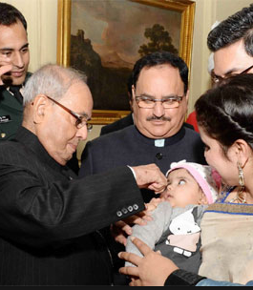
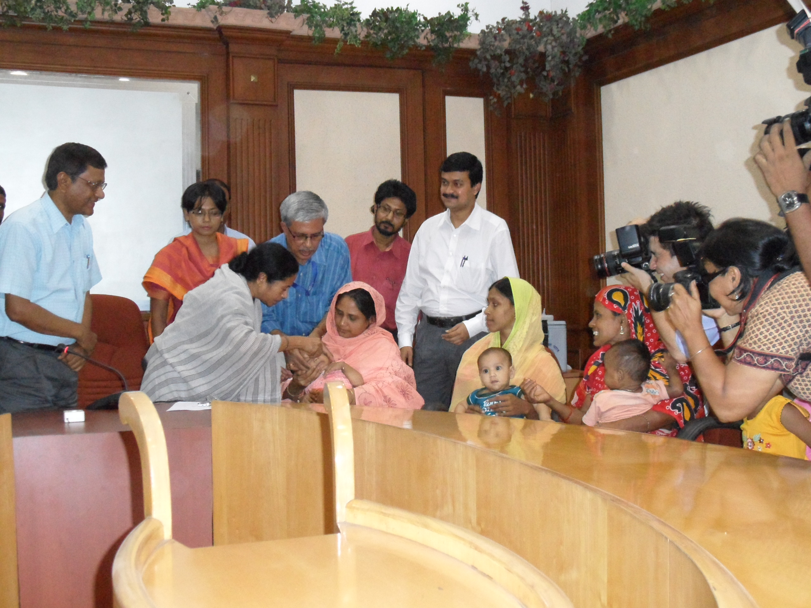
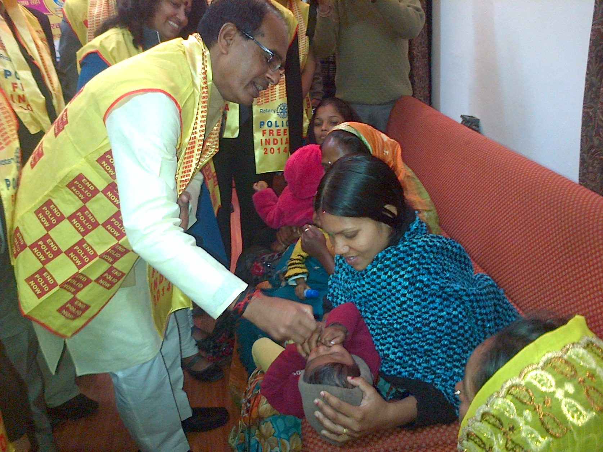
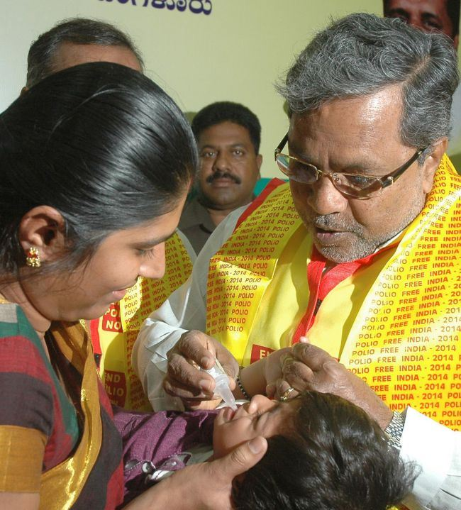
Highest level of political Commitment
Forner President of India
Mr Pranab Mukherjee
Chief Minister of West Bengal Ms. Mamata Banerjee
Chief Minister of MP Sh Shivraj Singh Chouhan
Karnataka Chief Minister Sh Siddaramaiah

Slide 94
Thank You

